Slide 1

Bio Hackathon
Welcome Presentation

Slide 2




Thank you

Slide 3
What is biotech?

Slide 4
Who is St Andrews Biotech?

Slide 5
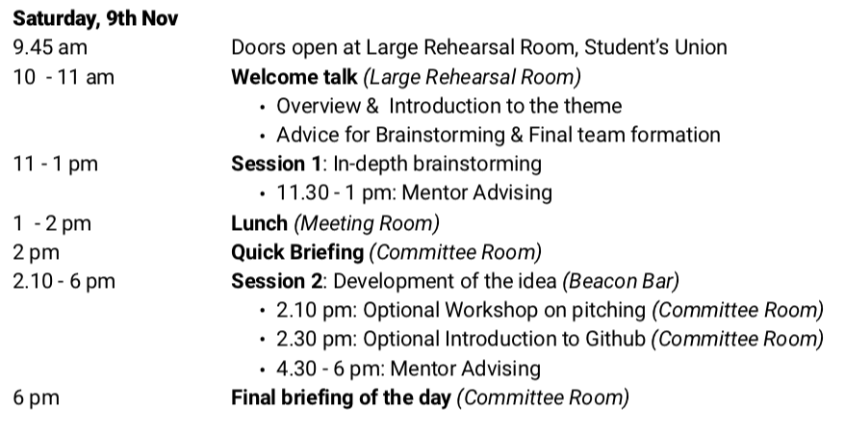
Schedule Saturday

Slide 6
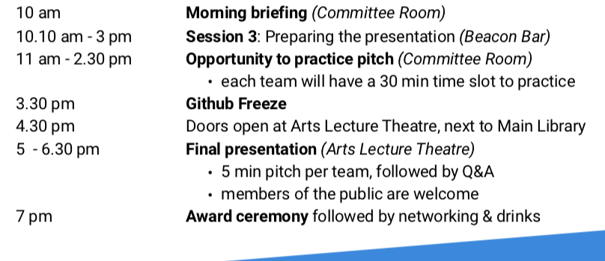
Schedule Sunday

Slide 7
Theme for Bio Hackathon 2019

Slide 8
Global Health
Theme for Bio Hackathon 2019

Slide 9
the area of study, research and practice that places a priority on improving health and achieving equity in health for all people worldwide
Definition of Global Health

Slide 10








Education & Political Stability
Mental Health
Sanitation & Water Access
Disability
Health Professionals
Treatments
Nutrition
Diagnostic

Slide 11
Bio-Tech iDeas - Biotech Society
An example: Team IISER-Mohali, iGEM 2018
Modelling and other examples

Slide 12
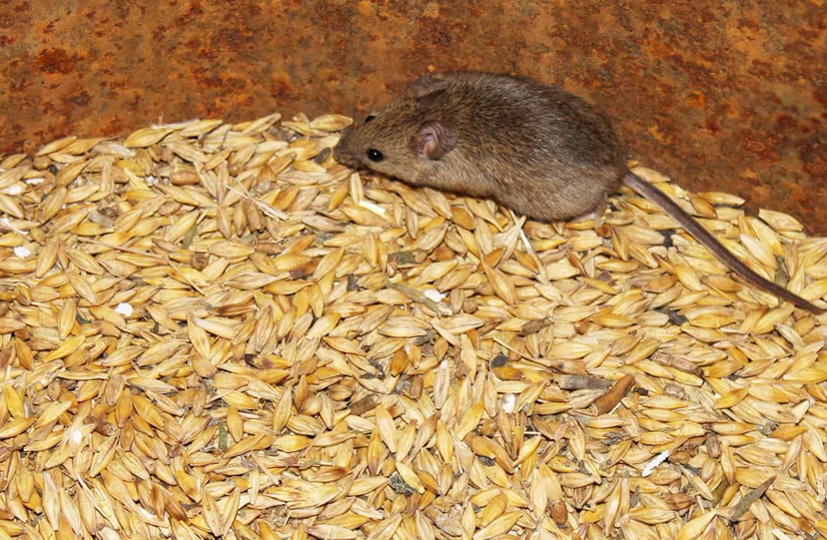
Step 1: Define the problem:
Agriculture is the primary source of livelihood for about 58 per cent of India’s population.
Storage of crops POST-HARVEST are
vulnerable to rodents that eat large
quantities of cereal and contaminate
stored crops with their droppings,
fur and saliva.
RESULT= post harvest losses
amount to 12 to 16 million metric
tons of food grains each year.

Slide 13
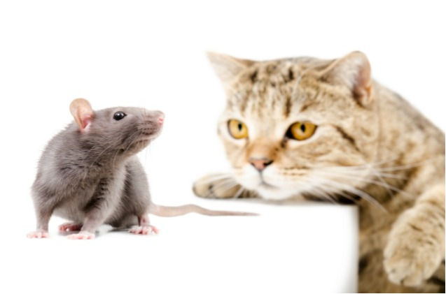
iDEA: Cat pheromones keep mice away!
PHEROMONES AND PROTEINS
IN CAT URINE PERCEIVED AS
A THREAT IN MICE

Slide 14

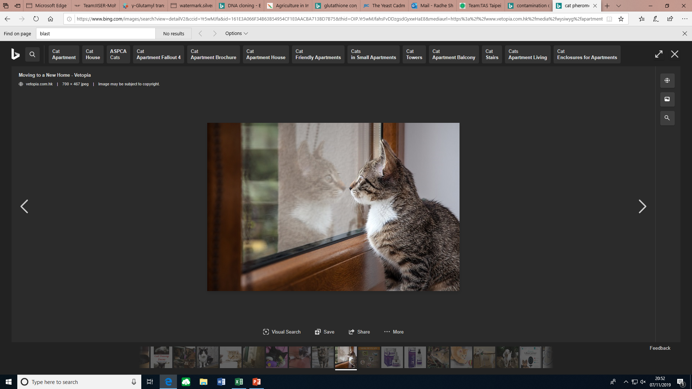
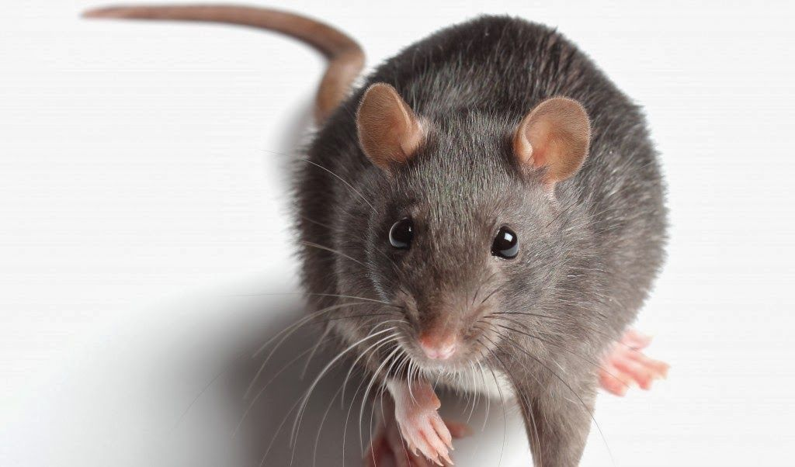
Define the solution:
Lets get yeast to do what the cat does and diffuse this to areas surrounding grain storage to keep the mice away
This inspired them to make the FearOmone (F)
Crop Storage
Yeast cell
Cat
p
Mice
F
Mice
Genetic engineering
p
NO ENTRY
F
NO ENTRY
p
F

Slide 15

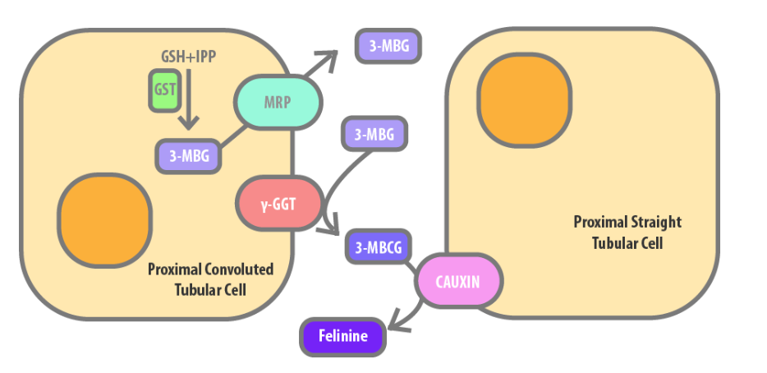
HOW TO DO THIS?
1.GST
1.
2.
3.
3.Enyme 1
2. GSH+IPP
4.Enzyme 2
glutathione (GSH) and isopentenyl pyrophosphate (IPP) 3-methylbutanol-glutathione (3-MBG)
3-MBG are converted to cysteinylglycine , S-conjugates (3-MBCG) by gamma-GGT, (gamma glutamyl transferase)
3-MBCG are hydrolyzed by cauxin to give rise to felinine.

Slide 16
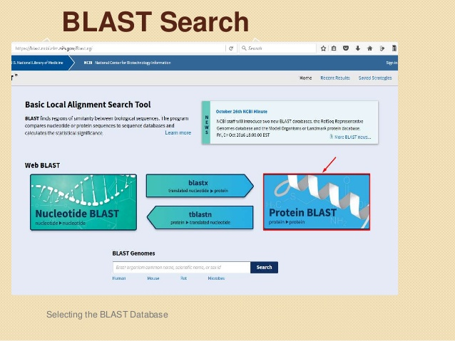
Step 2: Identify a model e.g. Saccharomyces cerevisiae (Yeast)
Question: Are there any felinine pathway gene homologs that are present in other species?
Tools: bioinformatics (e.g. BLAST- a
tool to determine identity between
DNA sequences) and literature mining.

Slide 17
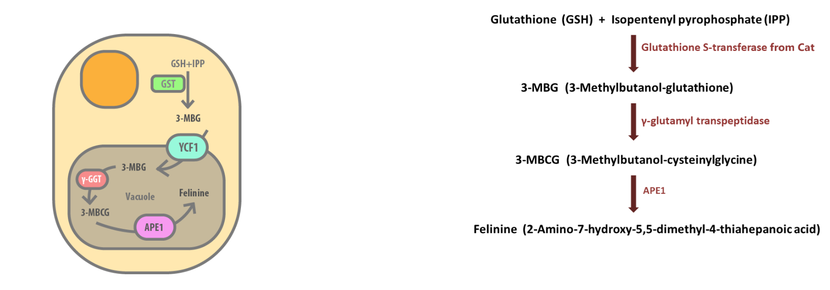
Step 3.Propose the Felinine pathway in YEAST
1.GST missing
2. GSH+IPP
3.Enyme 1
4.Enzyme 2
Milestone: Yeast have the a lot of these molecules that are needed for felinine synthesis!

Slide 18

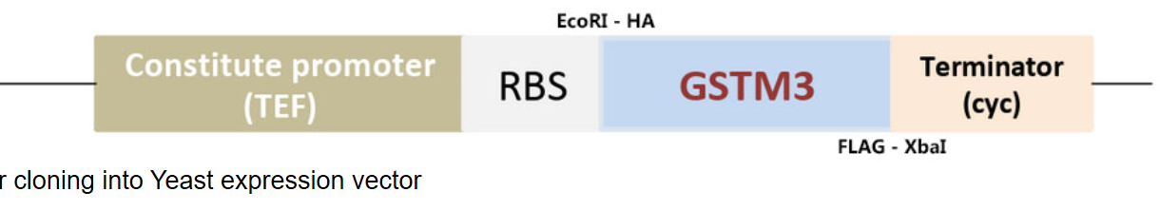
Next course of action:
What are we missing? We need the GST gene in yeast.
Problem: Yeast does not have the GST gene!
Solution: Let’s introduce it from cats!
1) Introduce the cat gene - GSTM3 gene- into a plasmid!
2) A plasmid / a vector will carry this gene into the yeast cell.
Plasmid
GST GENE

Slide 19
REDUCE POST-HARVEST LOSS- KEEP MICE AWAY
They successfully synthesized the FearOmone.
Crop Storage
Yeast cell
Cat
p
F
Mice
Genetic engineering
Mice
p
NO ENTRY
F
NO ENTRY
p
F

Slide 20
Modelling:
Validation and expression of FearOmone in yeast!
Simulation studies and also intelligently design hardware
EFFUSE - EFflux of FearOmone for optimal USE - This software built using Python uses Molecular Dynamics simulations to determine the rate of diffusion of small molecules out of the cell that are being produced in any compartment.
Using simulation studies with rats and pheromone diffusion, we aim to create a software that will take as input, dimensions of the storage area, locations of the food grains, etc. Users can provide additional information such as locations of doors, windows and other openings which can serve as entry points for rats. FearOmone will be simulated to be spreading outwards radially with the concentration following a time varying radial distribution from the point of device deployment.

Slide 21
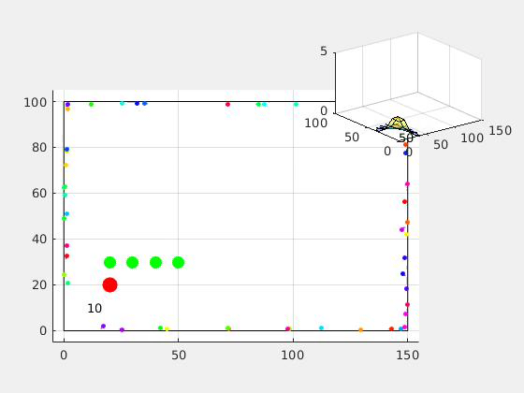
Using simulation studies with rats and pheromone diffusion

Slide 22
A new smartphone app that can read medical test strips
A new smartphone app can be used in home, clinical, or resource-limited settings to read commercially available urine test strips without requiring any external hardware. These urine test strips can be used to measure glucose, protein, or pH in the urine.

Slide 23
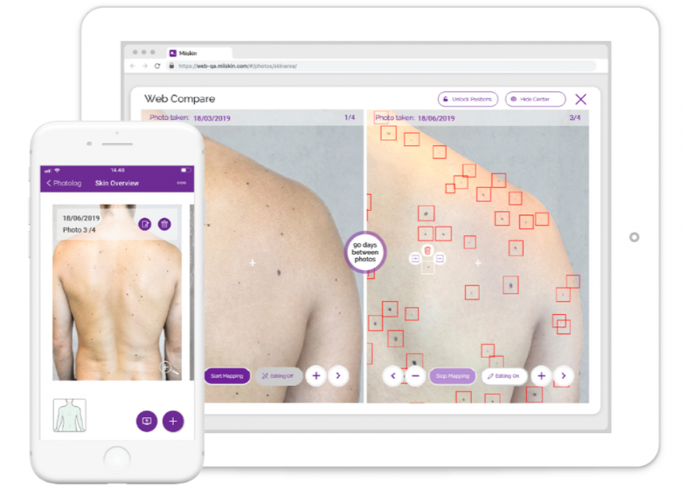
Mole-Mapping App Uses AI To Help Adults Detect Warning Signs Of Melanoma

Slide 24

TapTapSee
Assistive Technology for the
Blind and Visually Impaired
An Artificial Intelligence that helps the Blind and Visually Impaired with real time Image analysis

Slide 25
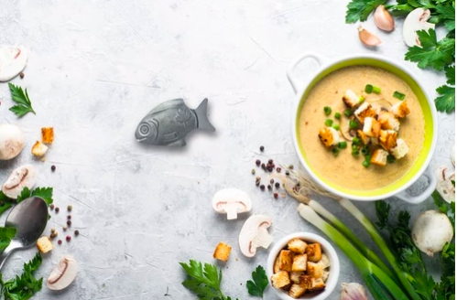
The Lucky Iron Fish® is a simple tool that adds extra iron to your daily foods.

Slide 26
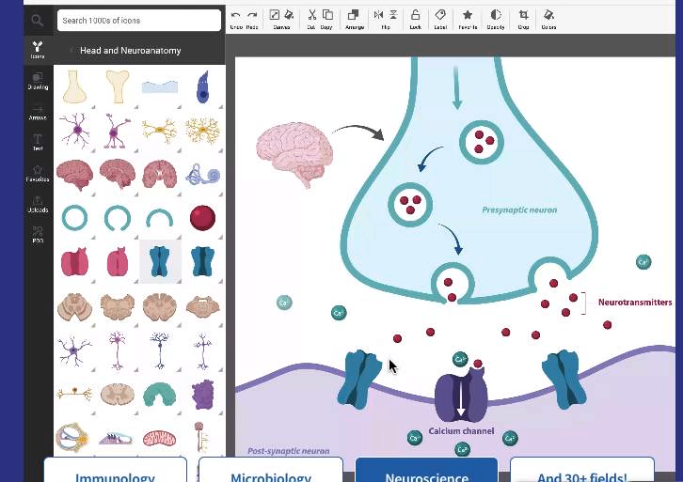
BioRender
https://biorender.com/

Slide 27
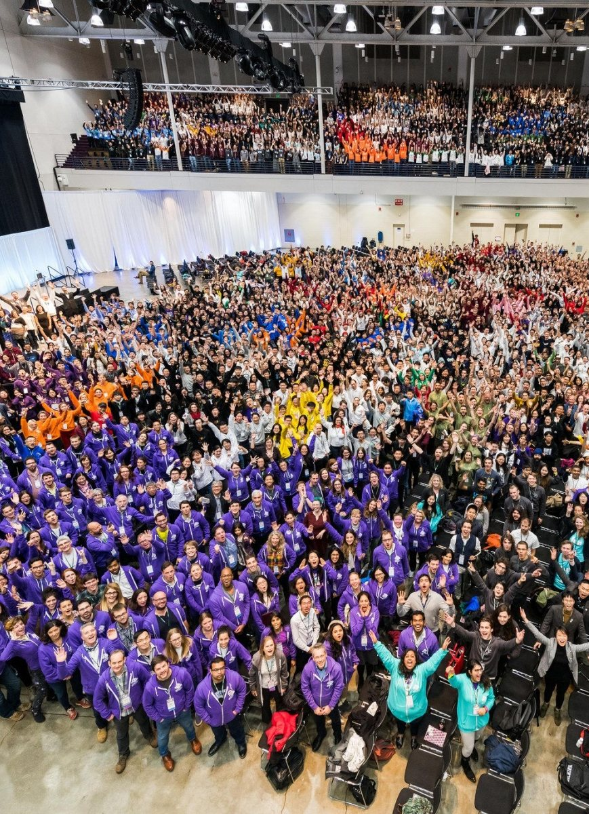
IGEM

Slide 28

Bright Scidea Challenge

Slide 29

SANTANDER UNIVERSITITIES Entrepreneurship award

Slide 30
Judging Criteria
Adherence to the theme
Business model
Technological feasibility
Presentation
Progress demonstrated as a team

Slide 31
Team Formation

